Slide 1
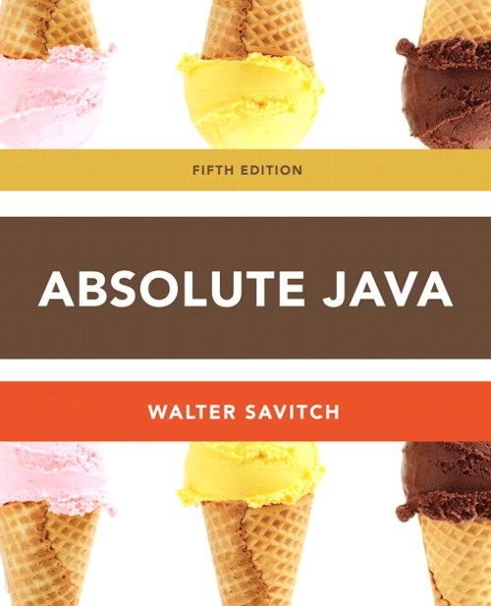
Chapter 1
Section 1.3
The CLASS String
Slides prepared by Rose Williams, Binghamton University
Kenrick Mock, University of Alaska Anchorage

Slide 2
The Class String
There is no primitive type for strings in Java
The class String is a predefined class in Java that is used to store and process strings
Objects of type String are made up of strings of characters that are written within double quotes
Any quoted string is a constant of type String
"Live long and prosper.“
A variable of type String can be given the value of a String object
String blessing = "Live long and prosper.";

Slide 3
Concatenation of Strings
Concatenation: Using the + operator on two strings in order to connect them to form one longer string
If greeting is equal to "Hello ", and javaClass is equal to "class", then greeting + javaClass is equal to
"Hello class“
Any number of strings can be concatenated together
When a string is combined with almost any other type of item, the result is a string
"The answer is " + 42 evaluates to
"The answer is 42"

Slide 4
Classes, Objects, and Methods
A class is the name for a type whose values are objects
Objects are entities that store data and take actions
Objects of the String class store data consisting of strings of characters
The actions that an object can take are called methods
Methods can return a value of a single type and/or perform an action
All objects within a class have the same methods, but each can have different data values

Slide 5
Classes, Objects, and Methods
Invoking or calling a method: a method is called into action by writing the name of the calling object, followed by a dot, followed by the method name, followed by parentheses
This is sometimes referred to as sending a message to the object
The parentheses contain the information (if any) needed by the method
This information is called an argument (or arguments)

Slide 6
String Methods
The String class contains many useful methods for string-processing applications
A String method is called by writing a String object, a dot, the name of the method, and a pair of parentheses to enclose any arguments
If a String method returns a value, then it can be placed anywhere that a value of its type can be used
String greeting = "Hello";
int count = greeting.length();
System.out.println("Length is " + greeting.length());
Always count from zero when referring to the position or index of a character in a string

Slide 7
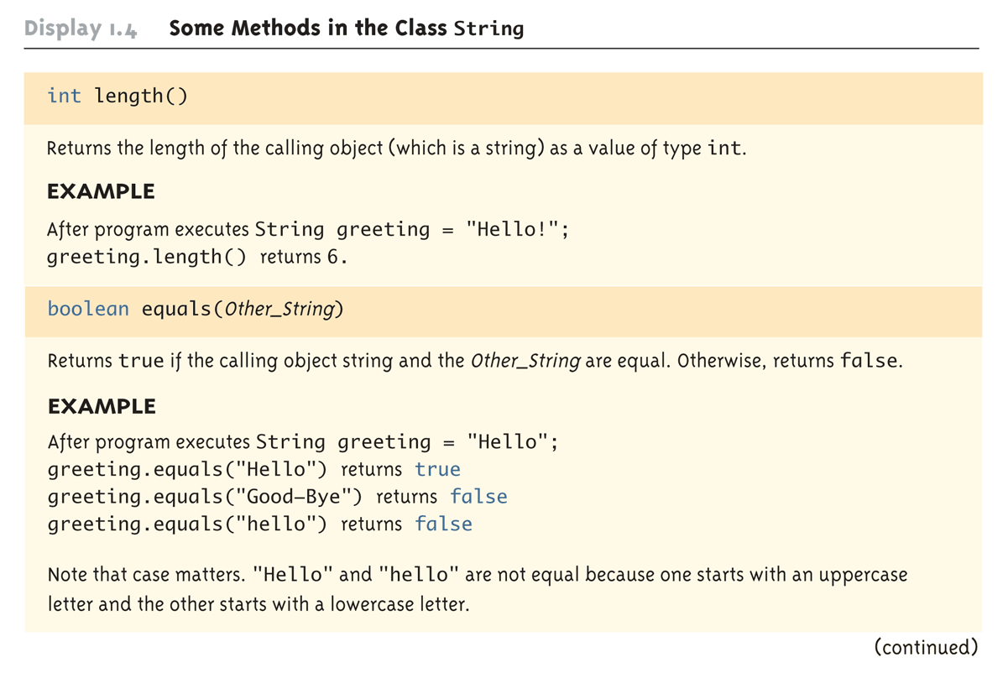
Some Methods in the Class String (Part 1 of 8)

Slide 8
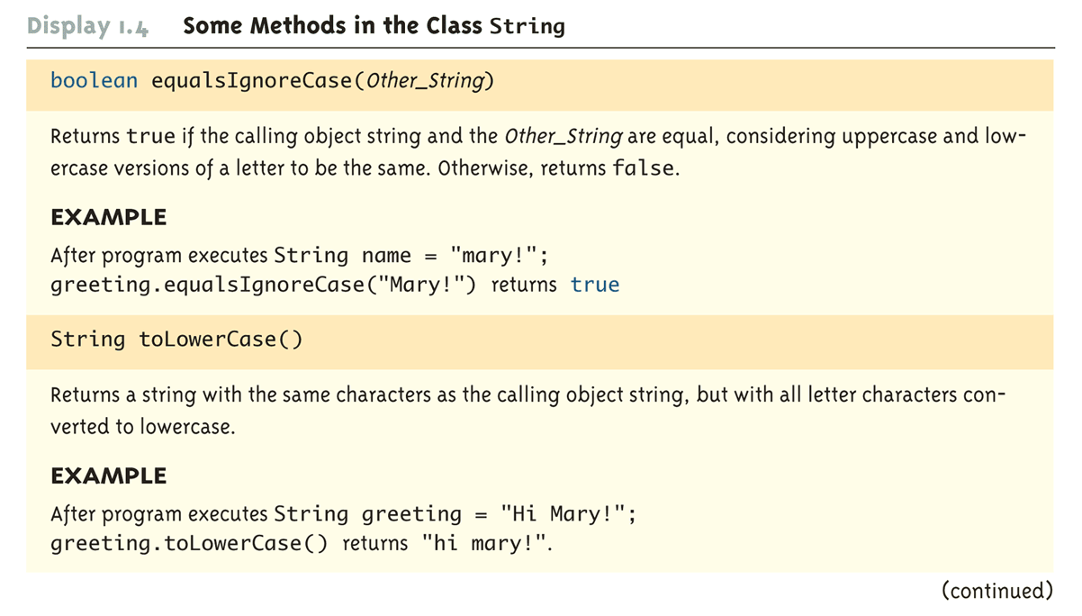
Some Methods in the Class String (Part 2 of 8)

Slide 9
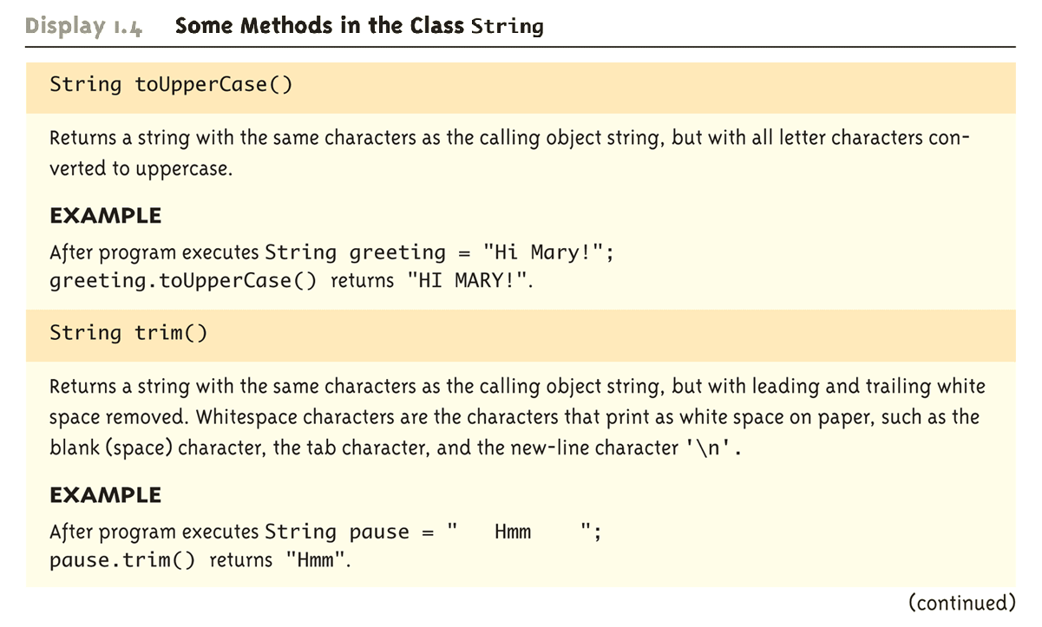
Some Methods in the Class String (Part 3 of 8)

Slide 10
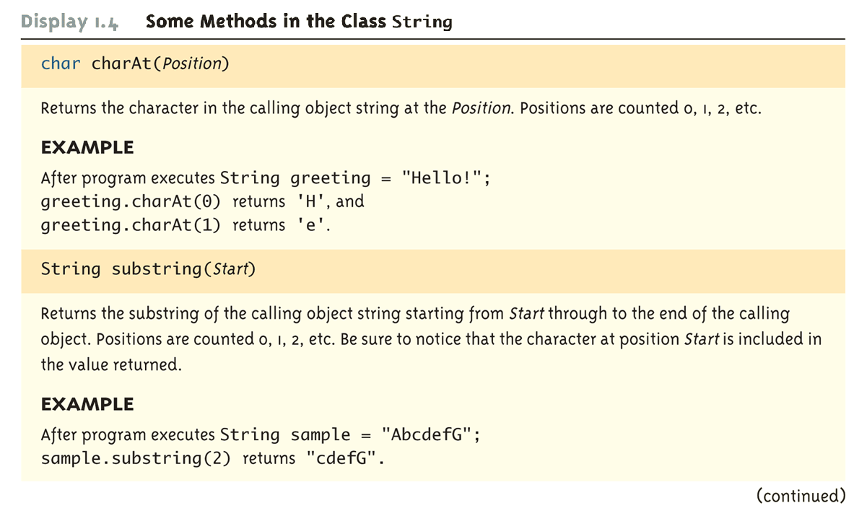
Some Methods in the Class String (Part 4 of 8)

Slide 11
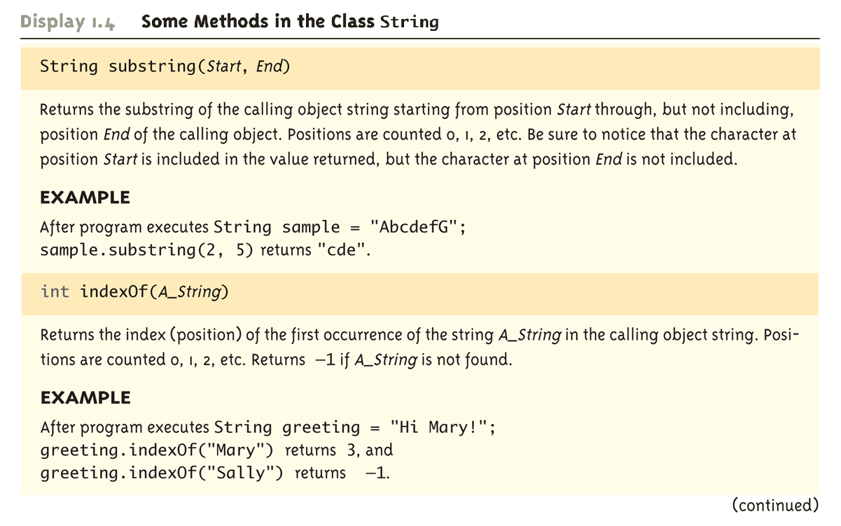
Some Methods in the Class String (Part 5 of 8)

Slide 12
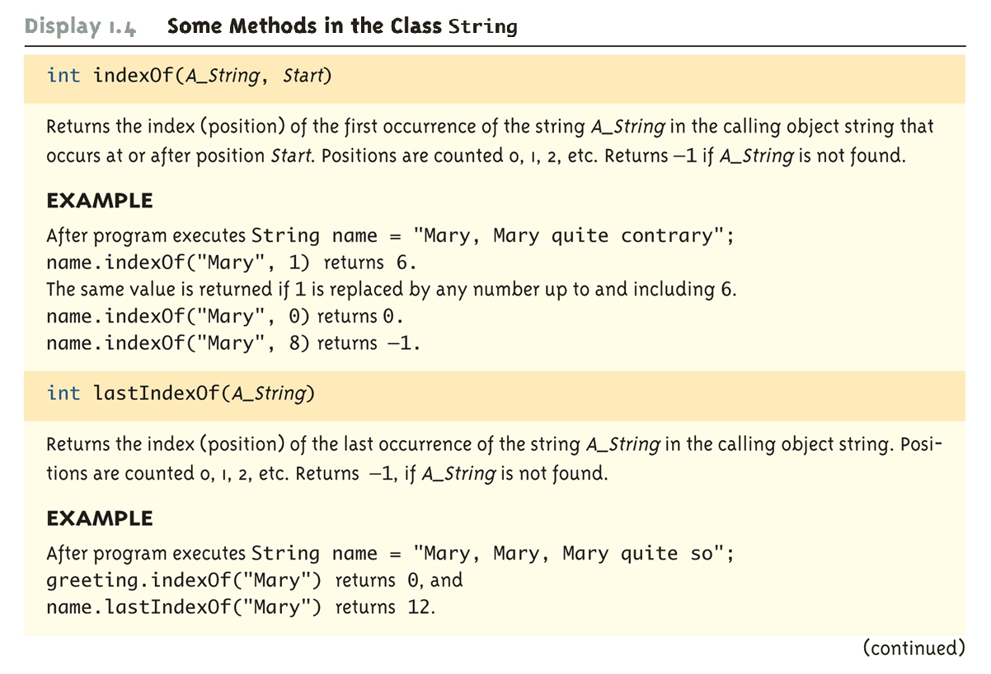
Some Methods in the Class String (Part 6 of 8)

Slide 13
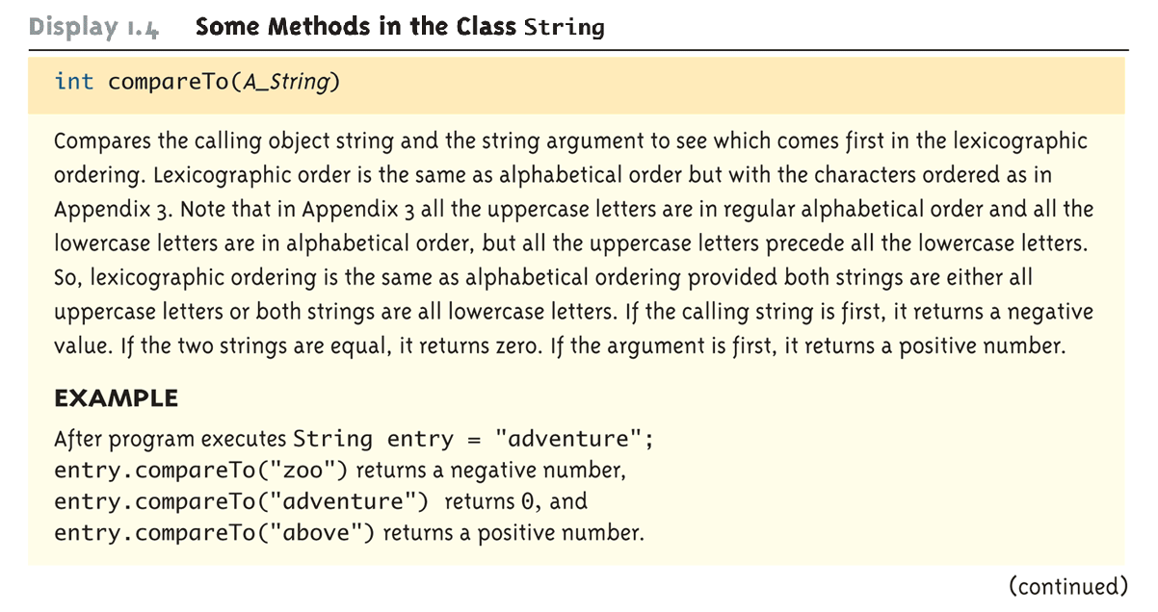
Some Methods in the Class String (Part 7 of 8)

Slide 14
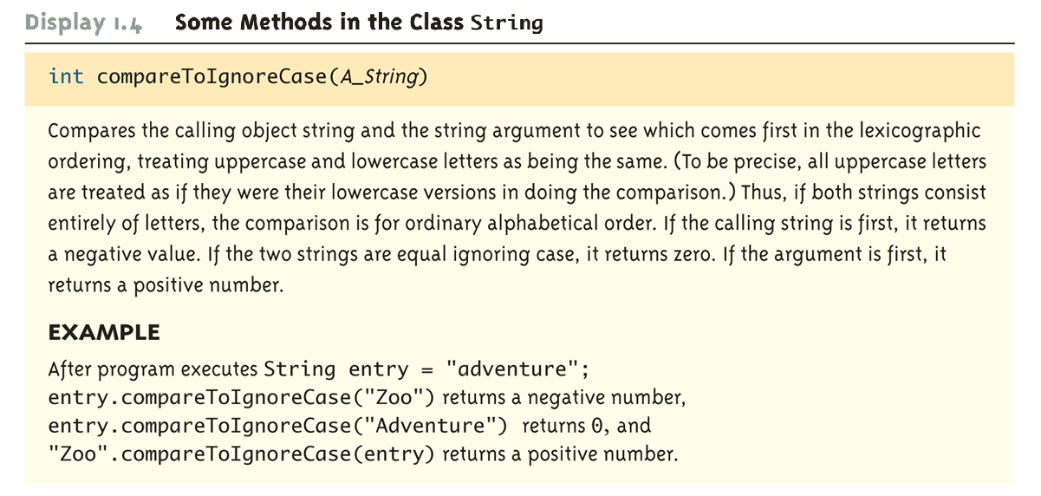
Some Methods in the Class String (Part 8 of 8)

Slide 15
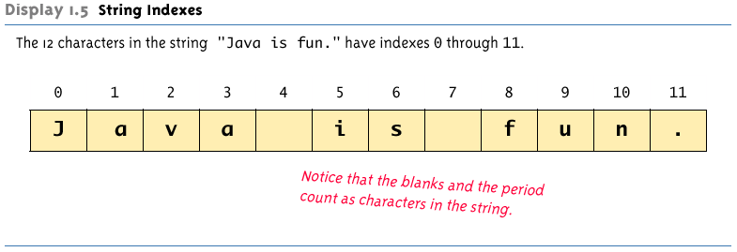
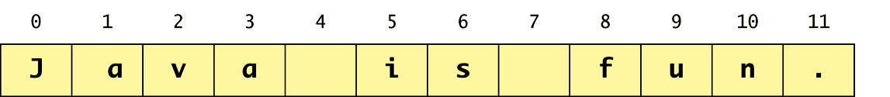
String Indexes

Slide 16
Escape Sequences
A backslash (\) immediately preceding a character (i.e., without any space) denotes an escape sequence or an escape character
The character following the backslash does not have its usual meaning
Although it is formed using two symbols, it is regarded as a single character

Slide 17
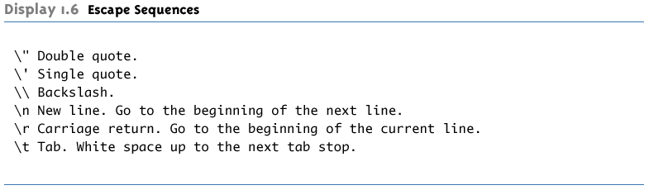
Escape Sequences

Slide 18
String Processing
A String object in Java is considered to be immutable, i.e., the characters it contains cannot be changed
There is another class in Java called StringBuffer that has methods for editing its string objects
However, it is possible to change the value of a String variable by using an assignment statement
String name = "Soprano";
name = "Anthony " + name;

Slide 19
Character Sets
ASCII: A character set used by many programming languages that contains all the characters normally used on an English-language keyboard, plus a few special characters
Each character is represented by a particular number
Unicode: A character set used by the Java language that includes all the ASCII characters plus many of the characters used in languages with a different alphabet from English

